Slide 1
Introduction to machine learning
Geocode meeting
5/10/19

Slide 2
What is machine learning?
A form of data analysis that automates model building
using algorithms that improve their performance
at some task with experience (data).

Slide 3
Why machine learning?
ML can identify patterns in large, complex data sets that may be difficult to discover with traditional approaches
Bergen et al. (2019), Science

Slide 4
Supervised Learning: Building models from examples
Data & Target (x,y)
Supervised Learning Algorithm
(e.g. neural network, random forest)
Training step
“cat”
“dog”
Labeled examples
(“Training data”)
Data x
Predictive Model f
Prediction step
”cat” or “dog”?
Target y=f(x)
“cat”

Slide 5

Unsupervised Learning
Unsupervised Learning Algorithm
(e.g. PCA, k-means)
Data X
Structure in X
Common patterns or features in images
OR
Images only
(no labels)
Groups of similar images

Slide 6





Basic ML workflow

Slide 7
Gather/Clean Data
Representing the Data
Build/Train the Model
Evaluation
Deploy
Identifying, parsing, & compiling data (from multiple sources)
Determining relevant data attributes
Data quality: missing data & outliers
Standardization: normalization, detrending, etc.
Exploratory data analysis
Split data into training & test sets

Slide 8
Gather/Clean Data
Representing the Data
Build/Train the Model
Evaluation
Deploy

Slide 9
Gather/Clean Data
Representing the Data
Build/Train the Model
Evaluation
Deploy

Slide 10
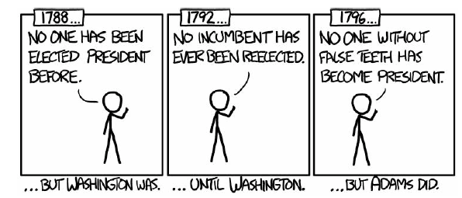
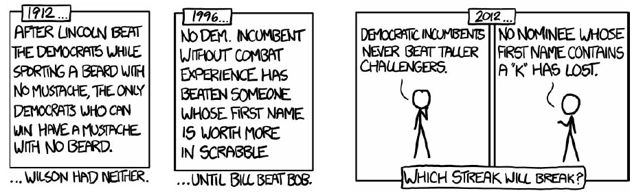
Gather/Clean Data
Representing the Data
Build/Train the Model
Evaluation
Deploy
https://xkcd.com/1122
The Overfitting Problem

Slide 11
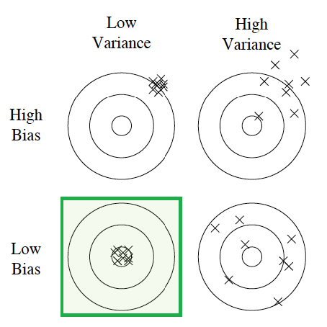
Gather/Clean Data
Representing the Data
Build/Train the Model
Evaluation
Deploy
Bias
Error due to model misspecification
(oversimplification)
Variance
Error due to sensitivity of model to fluctuations in training data
Domingos (2011)

Slide 12
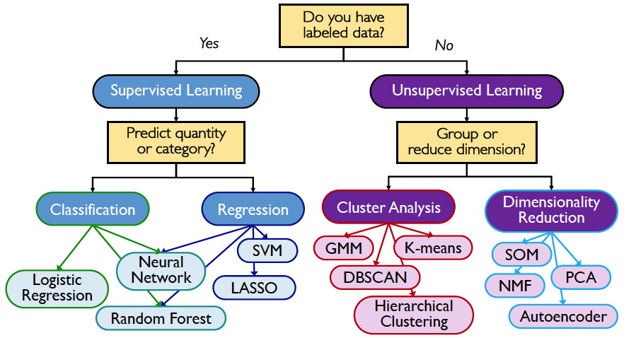
Gather/Clean Data
Representing the Data
Build/Train the Model
Evaluation
Deploy

Slide 13
Gather/Clean Data
Representing the Data
Build/Train the Model
Evaluation
Deploy
Training Data
Test Data
Training data
Set of observations used to train the model
Validation data
Set of observations used for evaluation during hyperparameter tuning
Test data
Held out observation used to measure generealization performance.
These data are not available to the algorithm during learning process

Slide 14
Gather/Clean Data
Representing the Data
Build/Train the Model
Evaluation
Deploy

Slide 15
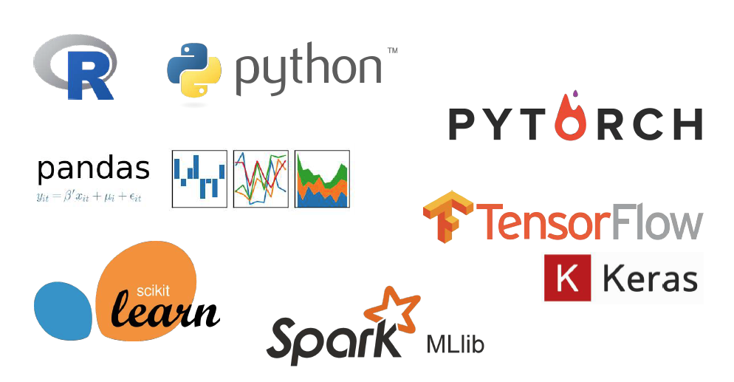
Popular ML packages

Slide 16
References and Resources
Witten et al. (2013) “Introduction to Statistical Learning with Applications in R.”
Kaufman et al. (2011) “Leakage in Data Mining: Formulation, Detection & Avoidance.”
Domingos (2011) “A Few Useful Things to Know about Machine Learning.”
ML for seismology reviews: Bergen et al. (2019), Science; Kong et al. (2018), SRL

